Slide 1

Hate Speech Detection
Group Name: Scalabe Minds
University: Mary Queen
Internship Domain: Data Science
Submitted By: Igwebuike Eze & Lucy Nowascki
Batch: LISUM32
Date: 1st July, 2024

Slide 2
Agenda
Executive Summary
Problem Statement
Project Approach
EDA
EDA Summary
Recommendations

Slide 3
Executive Summary
Detecting and mitigating hate speech on social media platforms is critical for fostering inclusive digital environments. Traditional large language models (LLMs) like GPT, BERT, and ILAMA are effective but resource-intensive, limiting their practicality for widespread deployment. Our focus is on developing models that balance effectiveness with resource efficiency, ensuring broader accessibility and scalability by comparing NanoGPT and xLSTM models.

Slide 4
Problem Description
The term hate speech is understood as any type of verbal, written or behavioural communication that attacks or uses derogatory or discriminatory language against a person or group based on what they are, in other words, based on their religion, ethnicity, nationality, race, colour, ancestry, sex or another identity factor. In this problem, We will take you through a hate speech detection model with Machine Learning and Python.
Hate Speech Detection is generally a task of sentiment classification. So for training, a model that can classify hate speech from a certain piece of tweet can be achieved by training it on a data that is generally used to classify sentiments. So for the task of hate speech detection model, We will use the Twitter tweets to identify tweets containing Hate speech.

Slide 5
Project Approach
Data Collection
Data Processing
Model Development
Evaluation
and
Comparon
Model
Deployment

Slide 6
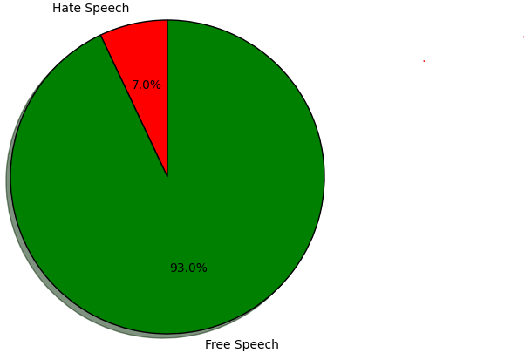
EDA

Slide 7
Recommendations
1. xLSTM model outperforms the nanoGPT model in terms of accuracy, precision, recall, and F1 score and does so with significantly fewer parameters making it a more efficient and effective solution for hate speech detection.
2. xLSTM offers superior performance while being resource-efficient, providing a strong competitive advantage in the NLP market.

Slide 8
Thank You

